Slide 1
Customer Churn Prediction
Random Forest vs XGBoost
Vinay Kartheek |AIML – SRM INSIDERS

Slide 2
Problem Statement
• Churn = a customer cancelling their subscription
• Keeping a customer is far cheaper than acquiring a new one
• Goal: predict which customers are likely to leave, so the business can act early
• Task: train Random Forest and XGBoost on the same data and compare them
What is Churn?
Predicting churn is typically treated as a supervised binary classification task. The target variable is categorical, usually labeled as 1 (the customer leaves) or 0 (the customer stays).

Slide 3
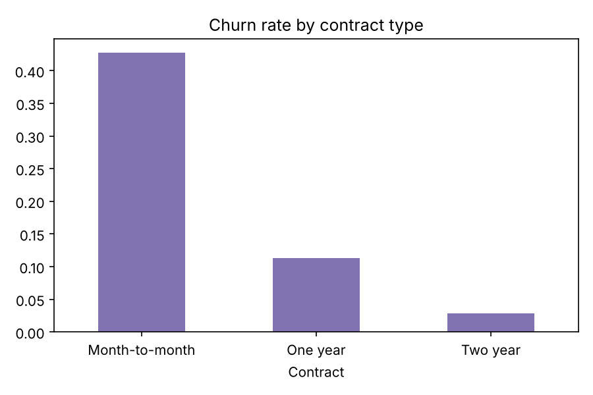
Dataset: IBM Telco Customer Churn
• 7,043 customers, 20 input columns, target = Churn (Yes/No)
• Columns: contract type, tenure, monthly & total charges, internet/phone services, payment method
• Imbalanced: 26.5% churn, 73.5% stay
• Month-to-month contracts churn far more than 1- or 2-year contracts

Slide 4
Preprocessing & Setup
• TotalCharges stored as text → converted to number; 11 blanks (new customers) set to 0
• Dropped customerID (no predictive value)
• One-hot encoded categorical columns → 30 features
• Stratified 80/20 split, so train and test keep the same 26.5% churn ratio
• Tuning: RandomizedSearchCV, 20 trials, 5-fold stratified CV, optimise ROC-AUC
• Imbalance: class_weight='balanced' (RF), scale_pos_weight≈2.77 (XGBoost)

Slide 5
How the Two Models Work
• Random Forest (bagging): many deep trees trained independently on random samples and random feature subsets; final vote is averaged → mainly reduces variance
• XGBoost (boosting): shallow trees built one after another; each new tree fixes the errors of the previous ones → mainly reduces bias
• XGBoost adds L1/L2 regularisation, learning-rate shrinkage, and row/column subsampling to control overfitting
• Best RF: 200 trees, max_depth 8, min_samples_leaf 5
• Best XGBoost: 500 trees, max_depth 4, learning_rate 0.01, subsample 0.8

Slide 6
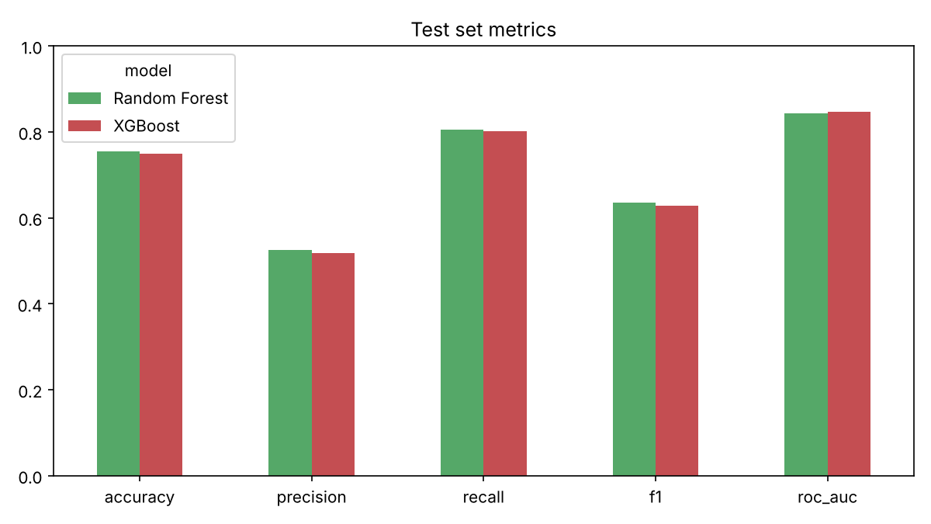
Results (Test Set, 1,409 customers)
Metric | Random Forest | XGBoost
Accuracy | 0.754 | 0.749
Precision | 0.524 | 0.517
Recall | 0.805 | 0.802
F1 | 0.635 | 0.629
ROC-AUC | 0.844 | 0.846
CV ROC-AUC | 0.848 | 0.849
Tuning time | 81 s | 16 s

Slide 7
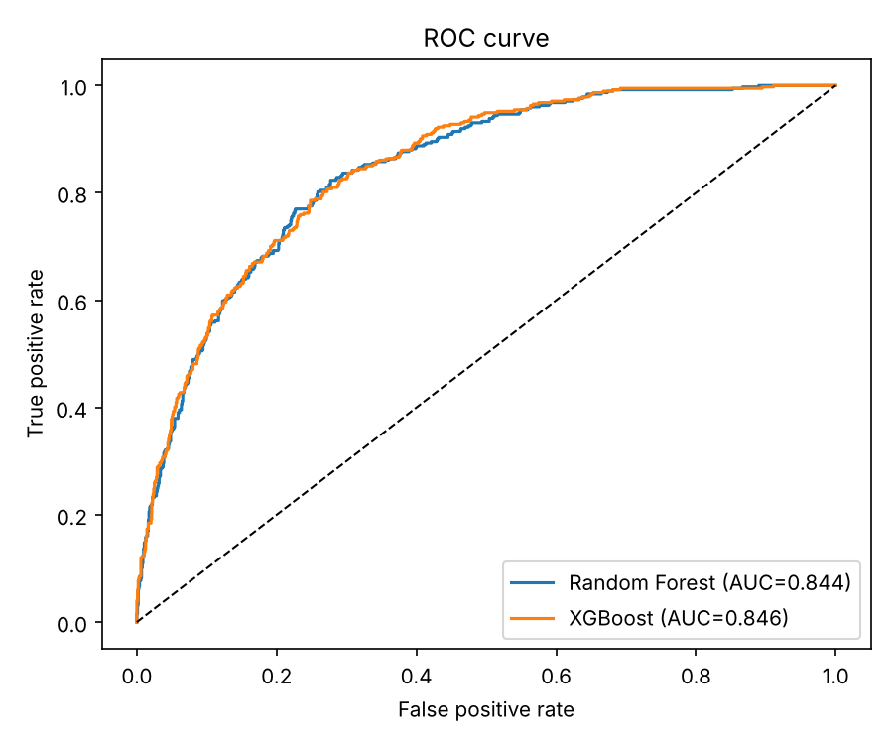
ROC Curves
• Both curves almost overlap
• XGBoost AUC 0.846 vs RF 0.844
• AUC is threshold-independent, so it is the fairest ranking metric here

Slide 8
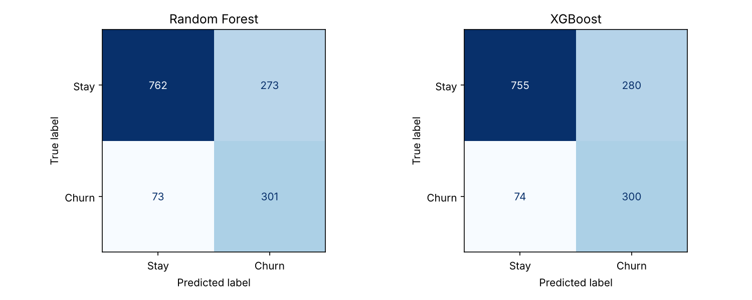
Confusion Matrices

Slide 9
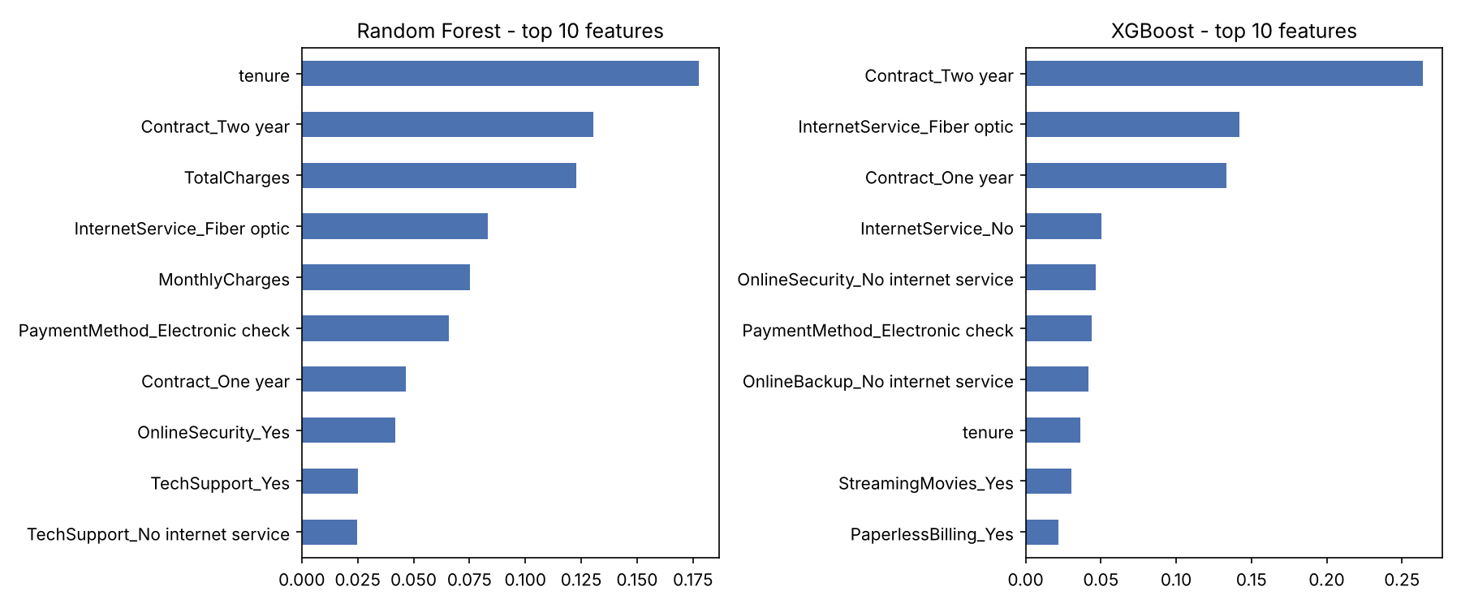
Feature Importance

Slide 10
Why XGBoost Came Out (Slightly) Ahead
• Higher ROC-AUC on both cross-validation (0.849 vs 0.848) and the test set (0.846 vs 0.844), so the edge is consistent, not luck of one split
• Boosting corrects mistakes sequentially, so it captures the borderline customers RF averages over
• Regularisation + small learning rate (0.01) with shallow trees (depth 4) generalises well on 7k rows
• About 5x faster to tune (16 s vs 81 s) because shallow trees are cheap and XGBoost is highly optimised
• Honest note: RF is marginally better on accuracy/F1 at the 0.5 threshold; the gap is tiny because a few strong features (contract, tenure, charges) dominate, so both models hit a similar ceiling

Slide 11
Conclusion & Next Steps
• Pick XGBoost: better ranking (AUC), faster, more tunable
• Both models catch ~80% of churners, useful for a retention campaign

